Slide 1
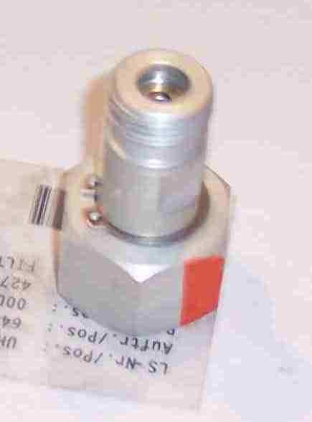
SIEMENS
HVCB SPARES
NRV for GAS Pipe
72.5KV,40KA, 145KV CB
S4712828701
NRV for GAS Pipe
72.5KV,31.5KA CB
S4947735700

